Slide 1

Embedded implementation science to enhance the relevance of effectiveness trials for structural interventions
Kenneth Sherr
ksherr@uw.edu

Slide 2
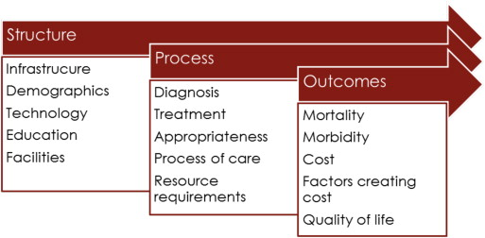
Taking a Systems Perspective
CONTEXT

Slide 3
Systems Analysis and Improvement Approach (SAIA): Package of systems engineering tools to optimize complex systems
Step 1: Cascade Analysis Tool (PCAT) application to identify high-yield steps for optimization
Gimbel, et al. The prevention of mother-to-child transmission of HIV cascade analysis tool: supporting health managers to improve facility-level service delivery. 2014.

Slide 4
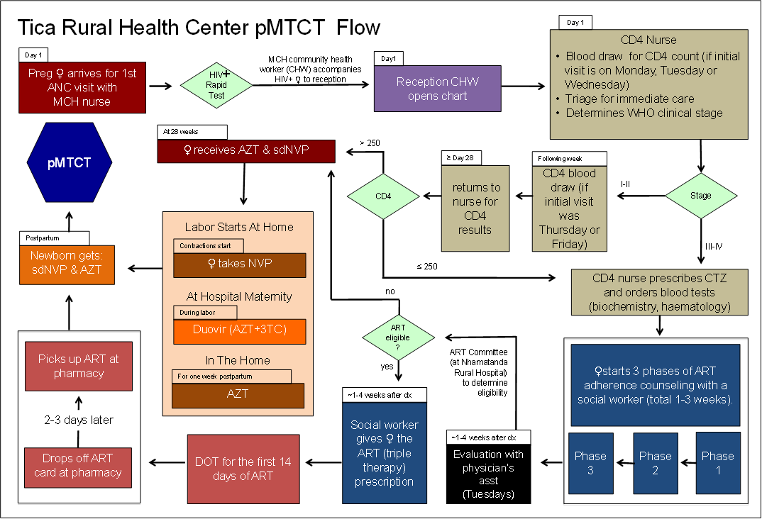
Step 2: Flow Mapping to Identify Waste/Bottlenecks, and Visualize System Reorganization

Slide 5
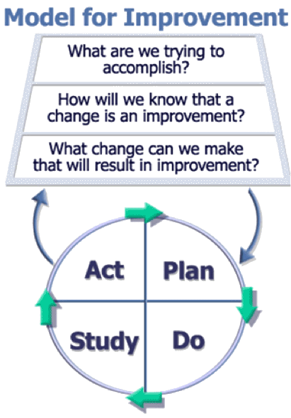
Step 3: Continuous Quality Improvement
Define & implement facility-specific workflow adaptations
Monitor changes in performance; initiate additional iterations
Repeat analysis and improvement cycle

Slide 6
SAIA Trial
Cluster RCT to assess effectiveness of SAIA on pMTCT service measures in 18 intervention/18 comparison facilities in Côte d’Ivoire, Kenya and Mozambique
Indicator | Numerator/Denominator
Uptake of HIV counseling and testing | # women counseled and tested for HIV in their first ANC visit/# first ANC visits
Use of appropriate ARVs in pregnancy | # HIV-infected pregnant women starting AZT prophylaxis or ART /# women testing HIV-positive in ANC 3 months previously
Infant HIV determination | # infants <6 weeks of age receiving a PCR test/# women testing HIV-positive in ANC 5 months previously
Sherr, et al. Systems analysis and improvement to optimize pMTCT (SAIA): a cluster randomized trial. Implementation Science. 2014.
Rustagi, et al. Impact of a systems engineering intervention on PMTCT service delivery in Cote d’ivoire, Kenya and Mozambique. JAIDS. 2016

Slide 7
Results: HIV-exposed Infant Screening
Mean (95% CI) change in HIV PCR screening coverage among HIV-exposed infants by 2 months of age from baseline to endline periods
 |  | n | Mean change | 95% CI |  | P
Overall | Control | 17 | 0.7% | -12.9% | 14.4% | 0.25
 | Intervention | 17 | 11.6% | 2.6% | 25.7%
Côte d'Ivoire | Control | 6 | 3.2% | -25.4% | 31.7% | 0.57
 | Intervention | 5* | 15.2% | -34.7% | 65.1%
Kenya | Control | 5** | -5.8% | -53.6% | 42.1% | 0.88
 | Intervention | 6 | -2.9% | -27.7% | 21.8%
Mozambique | Control | 6 | 3.7% | -13.1% | 20.6% | 0.04
 | Intervention | 6 | 23.1% | 10.3% | 35.8%
Baseline period = September 2013 – January 2014. Endline period = January–March 2015.
* 1 site had 0 infants who needed HEI during both the baseline and endline periods, so outcome 3 could not be calculated. ** 1 site did not offer infant testing until July 2014, so baseline estimates cannot be calculated.

Slide 8
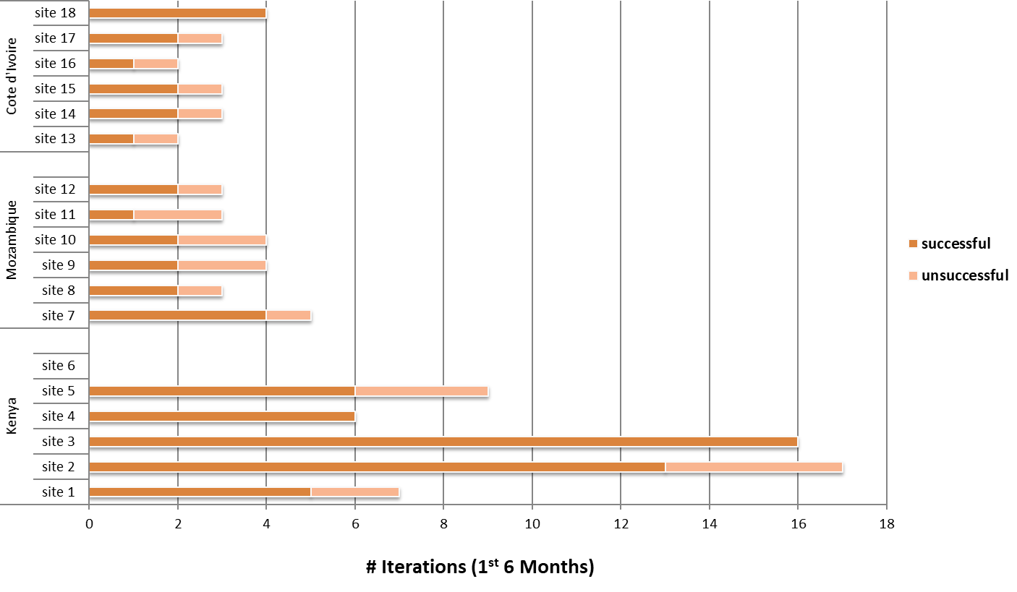
Results: # SAIA cycles by country (>80% deemed ‘successful’ by facility staff)

Slide 9
Results: Modifications Tested
Type of Change | Specific Example | Process Improvement
1. Service reorganization | CD4 blood draws changed from daily to weekly | HIV+ mothers with CD4 increased from 26% to 56%
2. Expand patient knowledge | Maternity tours provided to ANC patients | 16% increase in institutional births
3. Improve communication across the health care team | ANC nurses pick up lab results instead of waiting | Lab return time reduced from 6 weeks to 10 days
4. Improve data & its use | @shift change, head nurse cross checks pharmacy and maternity registries on infant ARV administration | 54% to 88% increase in correct administration
5. Introduce new interventions (norms, treatments, modalities, technologies) | (Re)test women with no test or >3 months prior HIV test, in Family Planning | 98-fold increase in testing after initial ANC screening (limited impact on identification of HIV+ women)

Slide 10
Qualitative Analysis Guided by the Consolidated Framework for Implementation Research (CFIR)
Intent was to:
  Define SAIA core and adaptable components
  Explain heterogeneity of observed SAIA results between facilities
Approach:
  6 focus group discussions at 6 study clinics (1 high, 1 low performing per country)
  Interviews with study staff and health system managers
  “Outer setting” domain collected prospectively via secular events monitoring
Gimbel, et al. Evaluation of a Systems Analysis and Improvement Approach to Optimize Prevention of Mother-To-Child Transmission of HIV Using the Consolidated Framework for Implementation Research. JAIDS 2016.

Slide 11
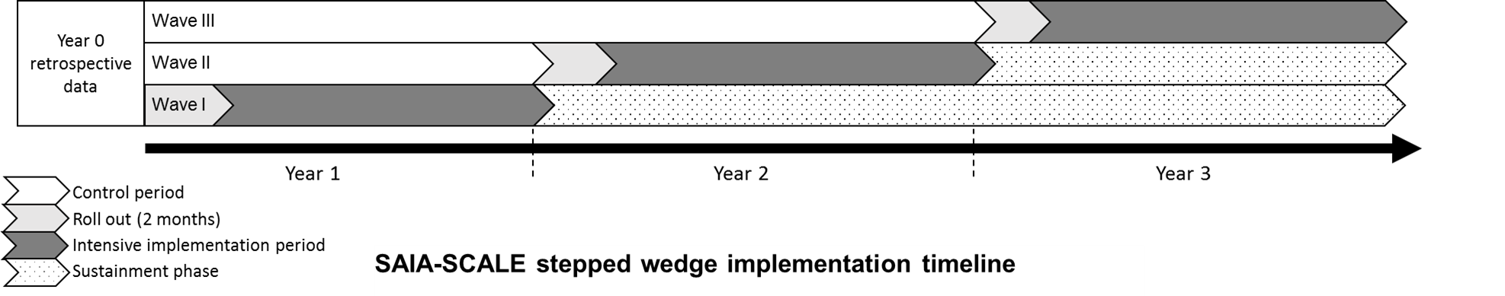
SAIA-SCALE (R01MH113435)
Goal: develop a dissemination and implementation model for the SAIA intervention (SAIA-SCALE) that is delivered by district maternal and child health (MCH) supervisors (rather than research nurses), to serve as a foundation for further scale-up
Application of IS methods:
  RE-AIM to structure the summative evaluation
  CFIR to describe/unpack implementation
  Multiple organizational readiness scales to identify determinants of adoption
Notes:
How will SAIA integrate and scale with the delivery system?

Slide 12

In Sum
Implementation science methods embedded in effectiveness trials of structural interventions explain the how and why of observed results
Context is not a nuisance variable
Variation in practice and observed impact across implementation units is an entry point to unpacking implementation

